Slide 1
Regularization in Spectral Domain
Yidong Ouyang

Slide 2
Outline
Basic Knowledge
Research Direction

Slide 3
Basic Knowledge
Spatial domain
The value of the pixels of the image change with respect to scene
Spectral domain
The rate at which the pixel values are changing in spatial domain
Fourier Transform and Inverse Fourier Transform
DFT
Conjugate symmetry

Slide 4
Basic Knowledge

Slide 5
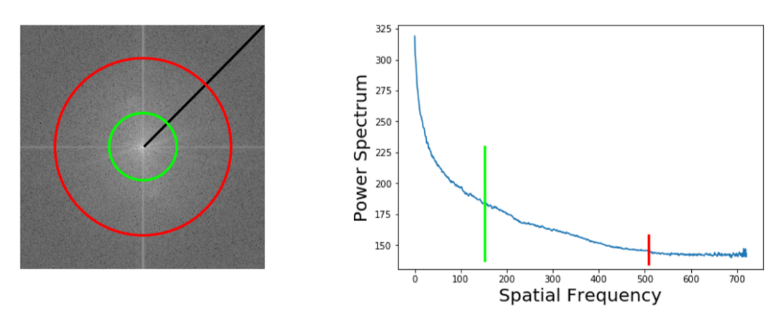
Basic Knowledge
2D power spectrum & 1D power spectrum
2D power spectrum(spectral density) is the squared amplitude spectrum
azimuthal integration over radial frequencies φ

Slide 6
Research Direction
Robustness
Generalization
Adversarial robustness
Theoretically understand the generalization ability of neural network
Theoretically understand the property of neural network
Regularization for generative model
Model compression & speed up

Slide 7
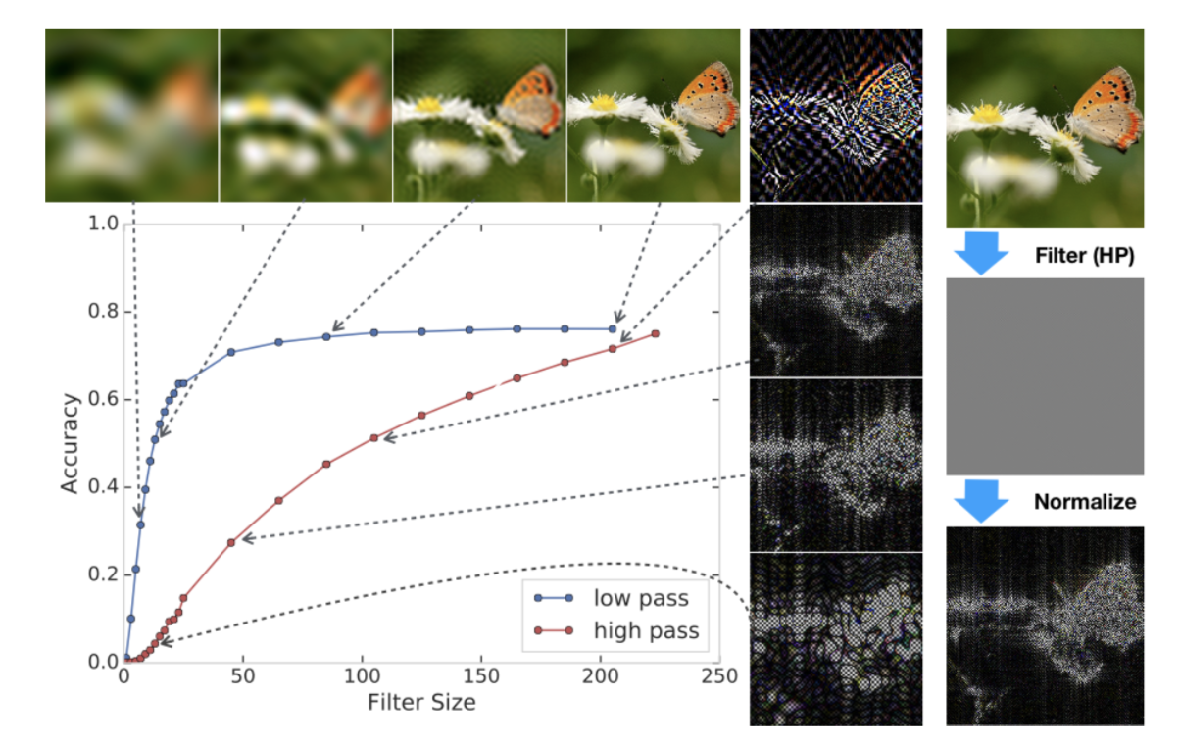
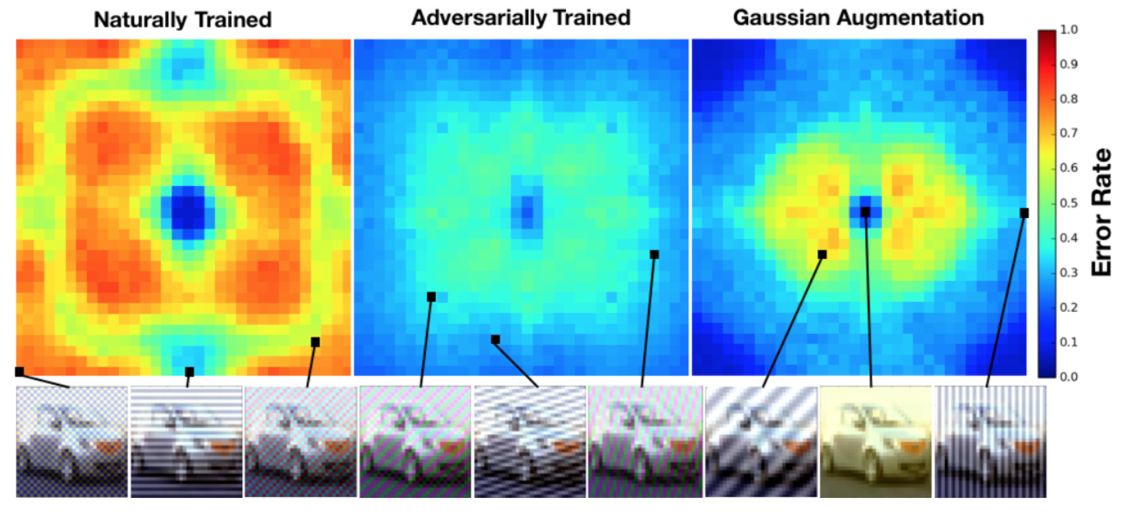
Robustness
A Fourier Perspective on Model Robustness in Computer Vision NIPS 2019

Slide 8
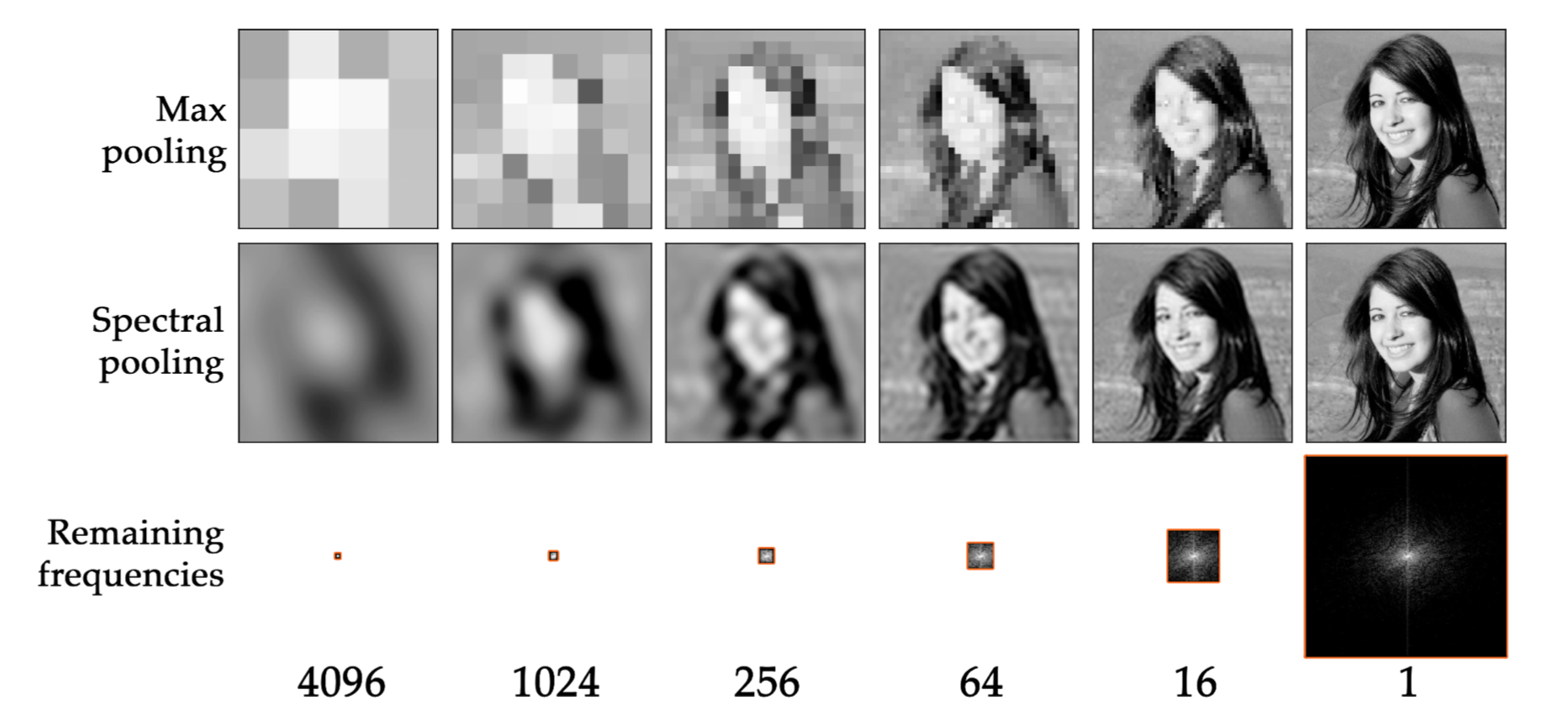
Generalization
Spectral Representations for Convolutional Neural Networks NIPS 2015

Slide 9
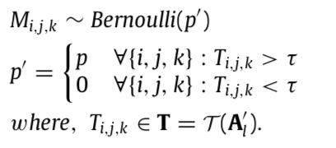
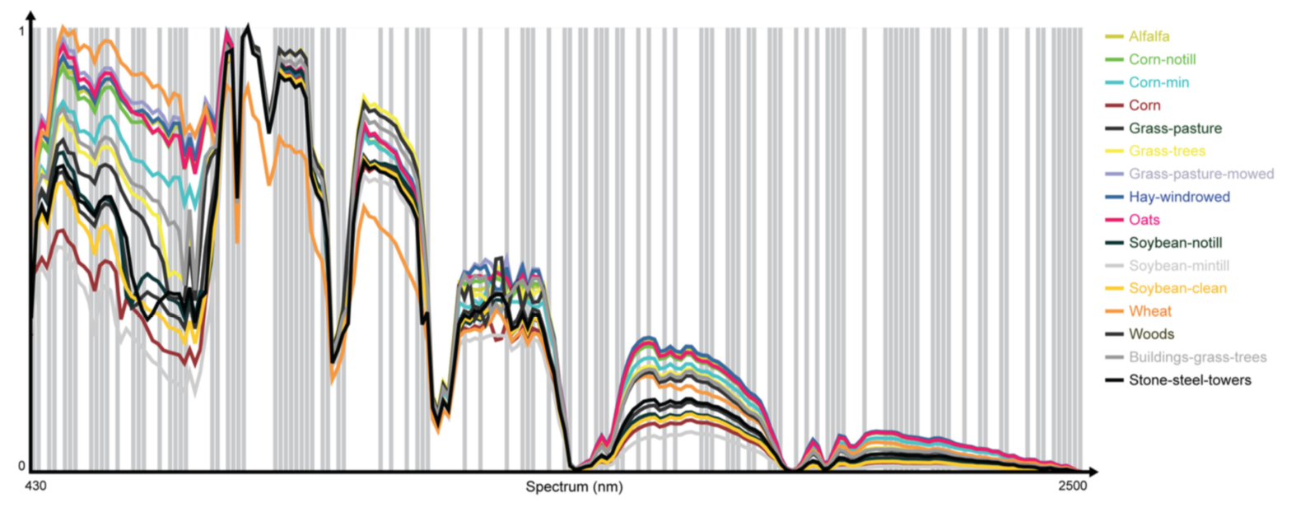
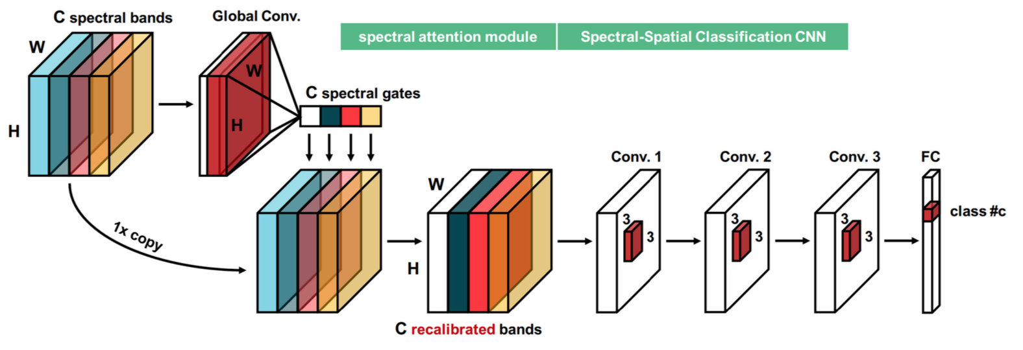
Generalization
Regularization of deep neural networks with spectral dropout
Learning to Pay Attention on Spectral Domain- A Spectral Attention Module-Based Convolutional Network for Hyperspectral Image Classification

Slide 10
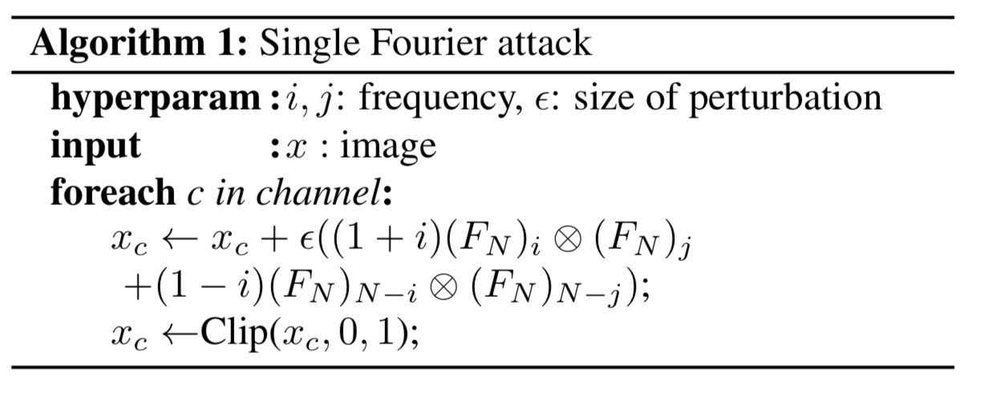
Adversarial robustness
On the Structural Sensitivity of Deep Convolutional Networks to the Directions of Fourier Basis Functions CVPR2019
Prove the singular vectors of a stacked convolutional layers with linear activation can be represented by a linear combination of single Fourier basis functions between input channels.
Explaining and Harnessing Adversarial Examples ICLR2015

Slide 11
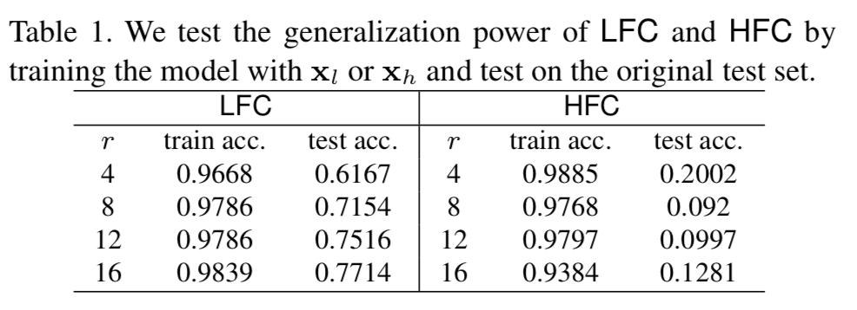
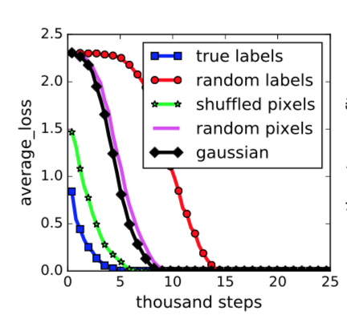
Theoretically understand the generalization ability of neural network
High-frequency Component Helps Explain the Generalization of Convolutional Neural Networks CVPR2020
Understanding Deep Learning Requires Rethinking Generalization ICLR2017 best paper

Slide 12
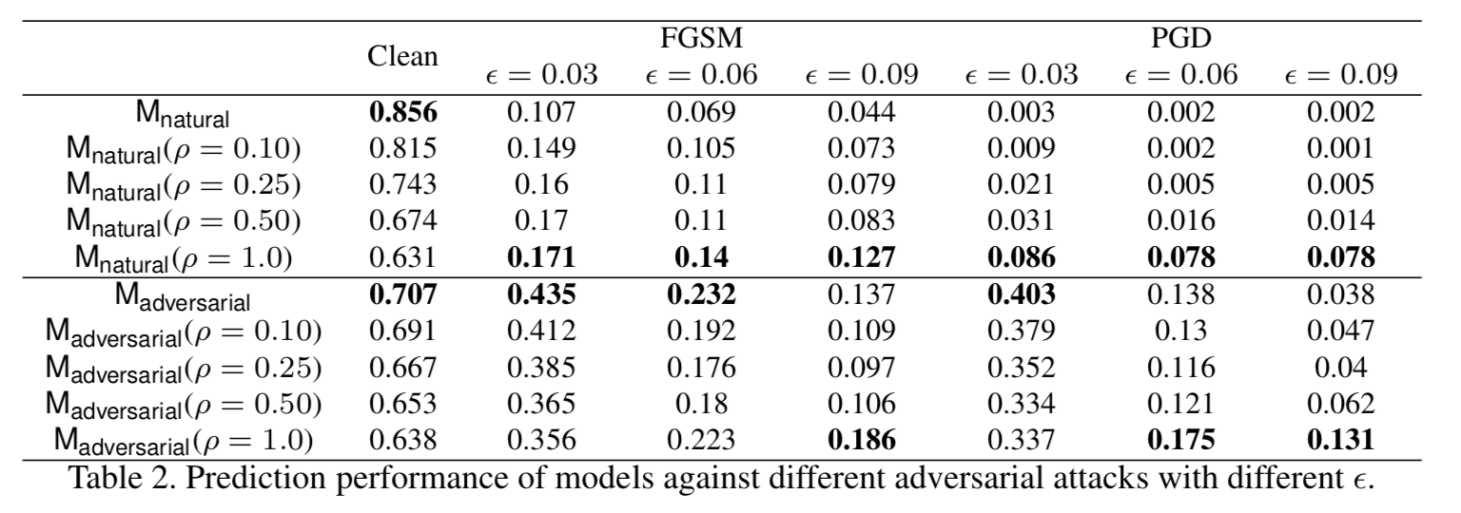

Slide 13
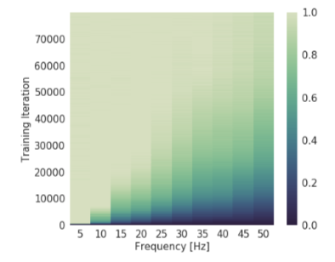
Theoretically understand the property of neural network
On the Spectral Bias of Neural Networks ICML2019
Higher frequencies being learned late in the optimization process
The numerator is O(Lf ) (where Lf is the Lipschitz constant of the function).
Lf is bounded by the parameter norm, which can only increase gradually during training by gradient descent.

Slide 14
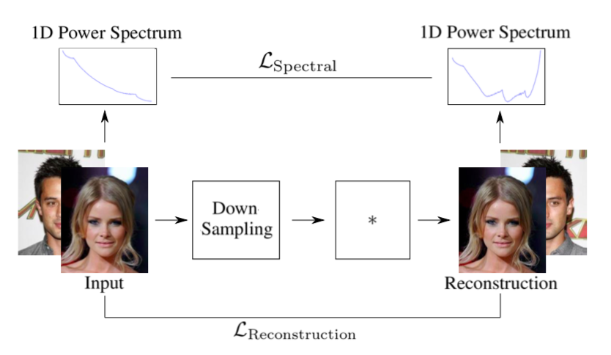
Regularization for generative model
Watch your Up-Convolution: CNN Based Generative Deep Neural Networks are Failing to Reproduce Spectral Distributions CVPR2020
binary cross entropy

Slide 15
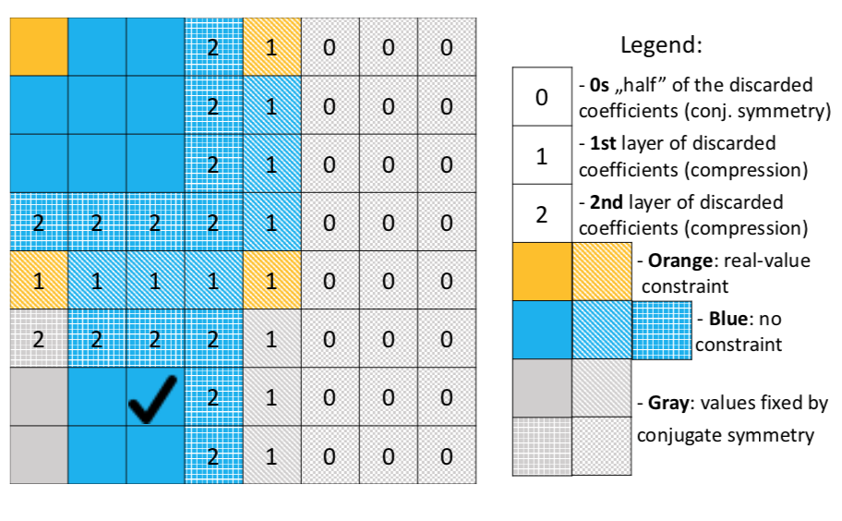
Model compression & speed up
Band-limited Training and Inference for Convolutional Neural Networks ICML2019

